Slide 1


COMMUNICATIONS MODELING
IN THE DIGITAL AGE

Slide 2

About Lance McKerley
Lance has more than 10 years of experience in communications and media relations for the long-term care industry. His company, founded in 2005, has provided PR, marketing or content development services for more than 75 individual health care facilities, trade associations and other organizations. He is an experienced seminar leader and coach in the areas of media relations, community relations, social media and effective business writing.
From 1999 to 2005 Lance contributed to a measurable improvement in the image of nursing homes and assisted living facilities as statewide spokesman for the long-term care industry in Tennessee. As director of communications for the Tennessee Health Care Association he helped to boost the association’s profile by implementing a number of successful PR campaigns and initiatives, including THCA’s first-ever Web site. Lance is past president of the Society of Long Term Care Communicators and a member of the Public Relations Society of America.
For more information go to mckerleycom.com/aboutlance.html

Slide 3

Special Challenges
Public Relations, Community Relations, Media Relations are changing at an unprecedented rate.
More tools, better tools and easier to use tools are at your disposal – if you are ready to use them.

Slide 4
Old Model
Human Interest Stories
See no evil, hear no evil
Hometown newspaper
“Gotcha” journalism

Slide 5
New Model
Do-it-yourself media: e-mail, internet and social media
Habits of the new twenty-something generation
Waning power of traditional media
You Tube, camera phones and everyone is watching

Slide 6


Slide 7
Understanding: The Key to Success
Communication as it applies to your daily responsibilities.
PR, Media Relations and Community Relations and what they can do for you.

Slide 8
Today’s Goals
Better understanding of new media and its importance as a marketing tool
How to communicate more successfully
How to interact successfully with the media
How improved communication can help you address the challenges and goals facing your facility or your organization.
How you can be ready to provide necessary information via the media when crisis strikes

Slide 9
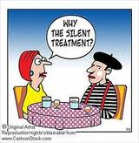
What is communication?

Slide 10


Slide 11
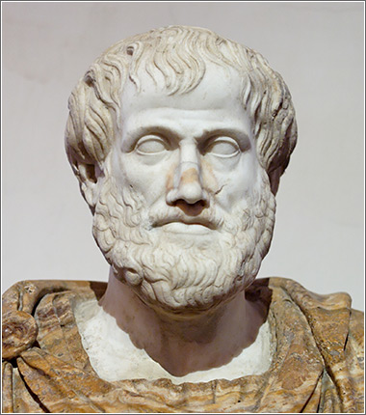
Aristotle’s Model
Communication, or “rhetoric,” is composed of three basic parts – the speaker, the message and the listener.
The person at the end of
the communication process
holds the key to whether or
not communication takes
place.

Slide 12
Communication
Models

Slide 16
Fields of Experience
Demographics: Gender, Age, Wealth,
Geography, Education
Politics
Business self-interest
Religion
Family status
Intelligence
Mood
Personality
Nationality or Heritage
Language
Species
The Unknown
Direct Experiences -- Best
Hearsay Experiences – Best

Slide 17
What do businesses do to bring these circles closer together?
What do politicians do to push these circles further apart?

Slide 18
How do WE move the circles?
Education to the target
Education to ourselves
Creativity
Technology
Competence
Success
Resources like KAHCF
Attitude
Openness
One-on-one -- Best
Word of mouth -- Best

Slide 19

The most important thing to understand is that communication is not just you broadcasting out to the universe. It’s you establishing commonality with an individual in any number of separate transactions.

Slide 20
Government
Us

Slide 21
Public Opinion
Government
Us

Slide 22
SNFs: What are our challenges?
Survival.
Attracting residents
Attracting employees
Liability
Public perception.
Recognition
Employee performance and attitude
We’d like our residents and families to understand what’s realistic. Community and media also.
What else?

Slide 23
Realities
Resistant to change
Too busy
Marketing is done in “survival mode”
Restrained by corporate
Restrained by GR
Media not receptive
Restrained by litigation
Lack of confidence
Media bias
Sometimes SNFs simply do some unfortunate things

Slide 24
As an administrator, department head or even a nurse or CNA relating to residents and their families, you control 90 percent of public perception WITHIN YOUR COMMUNITY

Slide 25
3 Elements of Rhetoric
PATHOS – an appeal to the audience’s emotions
ETHOS – an appeal to the honesty or authority of the speaker
LOGOS – an argument based on logic

Slide 26
Opening & Maintaining
Channels of Communication
Step 1: Remove Noise
Step 2: Establish Commonality
Step 3: Establish Credibility
Step 4: Make Ourselves Heard

Slide 27
How to Remove Noise
Remove barriers to communication.
Counteract disinformation
Take out the middle man

Slide 28
How do we establish credibility?
Being honest
Doing what we promise
Being as open as possible
Via third parties

Slide 29
How do we make ourselves heard?
This really is the million dollar question
Be creative
Be yourself
Be confident
Master the tools available to you

Slide 30

Community Relations = Marketing = Word of Mouth

Slide 31
Technology has opened up the pathways for your word-of-mouth allies to reach a wider audience. Even worldwide. Where word-of-mouth used to come from discussions over the fence or after church, it now comes via:
Internet applications
Social media
Smart phones

Slide 33


Slide 34


Slide 35
Media Relations Strategy

Slide 36
Crisis Communications

Slide 37
Maintain connectivity within your organization
Be readily accessible to the news media
Show empathy for the people involved
Provide distributed access
Maintain information security
Deliver high volume communications
Support multi-channel communications

Slide 38
Be honest.
Concerned parties are counting on you for information.
Don’t be afraid to say I Don’t Know.
Avoid passing along a rumor
Do not make a statement based on what is being reported already, unless you have confirmed it on your own.
If something has been reported that is in error, and you have confirmed the error, bring it out.

Slide 39
If you aren’t emotionally ready to do a TV interview, don’t do it.
If they want to interview someone else, let them do it. But you pick the person.
Either you or someone else needs to stay with the reporter(s) at all times until they have left your property.

Slide 40
Just the facts
Is the information essential?
Is it confirmed?
Is it understandable?
Are you the best source of the information?
Are there overwhelming liability issues at stake?
Have you talked with enough people to be reasonably sure you are not going to get blind-sided by facts you aren’t aware of?

Slide 41
Types of crises
  Some are acts of nature (floods, tornados) and some are acts of negligence.
  Some are BOTH.
  Assume the worst, until proven otherwise to your satisfaction.
  Avoid giving credit to heroes until then.

Slide 42
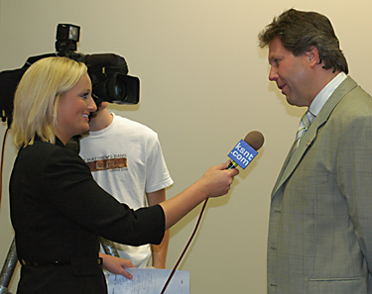
TV Interviews 101
You are walking into a room full of people you have never met.

Slide 43
3 Kinds of Questions
Just getting the facts
Fishing for a quote
Feeling you out

Slide 44

Thank You!
Thanks for the opportunity to talk with you today.
Don’t hesitate to contact me at any time if you have any followup questions about today’s seminar, or if you would like some advice on improving your communications strategy.
Lance McKerley, (615) 472-8974
www.mckerleycom.com

